Slide 1
DAA ASSIGNMENT
NITESH RAWAT - IIT2019099
MAITRY JADIYA - IIT2019100
ARYAN GUPTAII - IIT2019101
SUBMITTED TO: MD MERAZ

Slide 2
INTRODUCTION
This paper discusses about an algorithm that is designed to find the missing element in an array that represents elements of an arithmetic progression in order using divide and conquer approach.
An arithmetic sequence or progression(AP) is defined as a sequence of numbers in which for every pair of consecutive terms, the second number is obtained by adding a fixed number to the first one.
The array is already sorted either in increasing or decreasing order because, the elements of an array represent an arithmetic progression .
This paper also contains the analysis about the time and space complexities of the algorithm. By the end of the paper, we will be able to understand all the components of algorithm design and will learn different ways of analysing the algorithms.

Slide 3
ALGORITHM-1
1.Find the mid element of the array every time search range is divided and initialise a result variable which will keep index of mismatched index.Input array A with a missing element and an array B which has elements in proper arithmetic progression(also having the missing element of A) is taken.
2.Check the values of array A and B on the mid index and if the elements are same then it would mean that no element was missing in the AP till this index.In this case start searching only to the right of mid(right half of the current search range).
3.Check the values of array A and B on the mid index and if the elements are unequal then store the index in result and keep checking to the left of mid(left half of the current search range) as the minimum index of mismatched value is required.If a smaller index of mismatch is found then result is updated with this index.
4.The value of result is returned after the range becomes zero.
5.After performing all the steps for all the subproblems, if the value of result variable is unchanged, then no element is missing in the array, otherwise, print the value of the result variable.

Slide 4
CODE-1
#include<bits/stdc++.h>
using namespace std;
int binsearch(int a[],int b[],int n){
int start=0,end=n-1;
int mid,res;
while(start<=end){
mid= start+((end-start)/2);
if(a[mid]==b[mid]){
start=mid+1;;
}
else if(a[mid]!=b[mid]){
res=mid;
end=mid-1;
}
}
return b[res];
}
int main()
{
int n;
cin>>n;
int a[n],b[n];
for(int i=0;i<n;i++){
cin>>a[i];
}
if(n<=2){
cout<<"No element is missing"<<endl;
}
else{
b[0]=a[0];
int d=(a[n-1]-a[0])/n;
for(int i=1;i<n;i++){
b[i]=b[i-1]+d;
}
int ans=binsearch(a,b,n);
cout<<"The missing number is: "<<ans<<endl;}
return 0;
}

Slide 5
ALGORITHM-2
1. Find the mid element of the array and initialise an answer variable as the smallest integer that can be stored.
2. Check the difference between the middle element and its previous element. If the difference is not equal to the common difference of the AP, then store the missing number in an answer variable and make no further calls to the function, else proceed to next step.
3. Check the difference between the middle element and its next element. If the difference is not equal to the common difference of the AP, then store the missing number in a variable and make no further calls to the function, else proceed to next step. 2
4. If the current element is at its correct position, then divide the array into 2 halves, and perform the above steps in the later half, i.e. in the sub array from mid+1 till the end.
5. If the current element is not at its correct position, then divide the array into 2 halves, and perform the above steps in the first half, i.e. in the sub array from starting element till the mid.
6. After performing all the steps for all the subproblems, if the value of the answer variable is unchanged, then no element is missing in the array, otherwise, print the value of the answer variable.

Slide 6
CODE-2
#include <bits/stdc++.h>
using namespace std;
int ans INT_MIN;
void missingTerm(int a[], int l, int h, int d)
{
if(l>=h)
return;
int m=(l+h)/2;
int curr = a[0]+m*d;
if(a[m]-a[m-1]!=d && m+1<h)
ans=a[m-1]+d;
else if(a[m+1]-a[m]!=d && m+1<h)
ans=a[m]+d;
else if(a[m]==curr)
missingTerm(a,m+1,h,d);
else
missingTerm(a,l,m-1,d);
return;
}
int main() {
int n; cin>>n;
int a[n];
for(int i=0; i<n; i++) cin>>a[i];
if(n<3)
cout<<"Invalid Input"<<endl;
else {
int d;
if(a[2]-a[1]==a[1]-a[0])
d=a[1]-a[0];
else if(a[3]-a[2]==a[2]-a[1])
d=a[2]-a[1];
else
d=a[1]-a[0];
missingTerm(a,0,n-1,d);
if(ans > INT_MIN)
cout<<ans<<endl;
else
cout<<"No missing term"<<endl;
} return 0; }

Slide 7
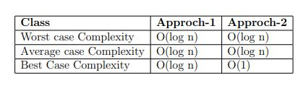
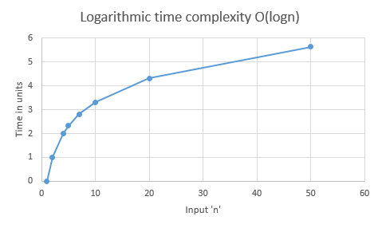
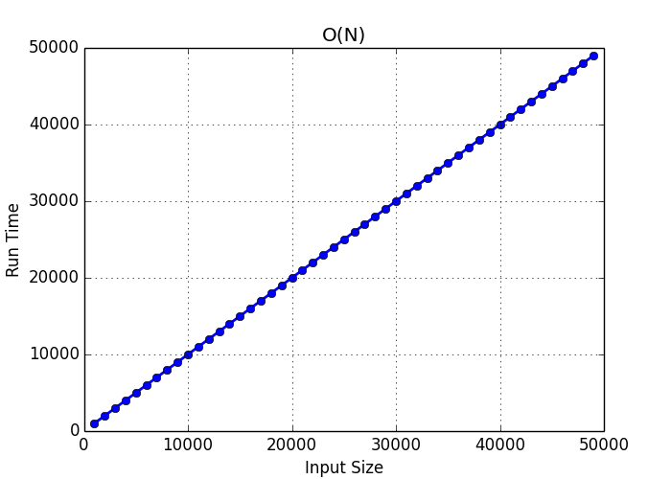
ANALYSING TIME COMPLEXITY

Slide 8
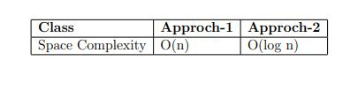
ANALYSING SPACE COMPLEXITY

Slide 9
CONCLUSION
We can conclude that the second algorithm has the least time and space complexity to find the missing element in an array that represents elements of an arithmetic progression in order. The other one has same worst and average time complexity but best case time complexity of first approach is less than second one. Also, it’s space complexity is more than the other one.

Slide 10
REFERENCES
[1] Introduction to Algorithms / Thomas H. Cormen . . . [et al.]. - 3rd edition.
[2] The Design and Analysis of Algorithms (Pearson) by A V Aho, J E Hopcroft, and J D Ullman
[3] Algorithm Design (Pearson) by J Kleinberg, and E Tard
[4] https://www.geeksforgeeks.org/findmissing-number-arithmetic-progression/

